Slide 1
Secure Data Hiding in Images using Steganography
CAPSTONE PROJECT
Presented By: Navaneeth Reddy Peddireddy
Student Name : Navaneeth Reddy Peddireddy
College Name & Department : CVR College of Engineering, CSE(Cyber Security)

Slide 2
OUTLINE
Problem Statement
Technology used
Wow factor
End users
Result
Conclusion
Git-hub Link
Future scope

Slide 3
Problem Statement
Traditional encryption methods are easily detectable, making secure communication vulnerable to attacks. Steganography hides secret data within images, ensuring confidentiality without raising suspicion. This project focuses on developing a secure and efficient image-based steganography system with minimal visual distortion. It enhances data privacy for sensitive communications in cybersecurity, journalism, and defense.

Slide 4
Technology used
• Python
• OpenCV
• NumPy
• Steganography Libraries (e.g., Stegano, LSB Steg)

Slide 5
Wow factors
• Uses LSB-based steganography for high security.
• Minimal visual distortion, keeping hidden data undetectable.
• Passcode-protected decryption for added security.
• Works with multiple image formats for flexibility.

Slide 6
End users
• Government and defense agencies
• Journalists and whistleblowers
• Cybersecurity professionals
• Individuals requiring private communication

Slide 7
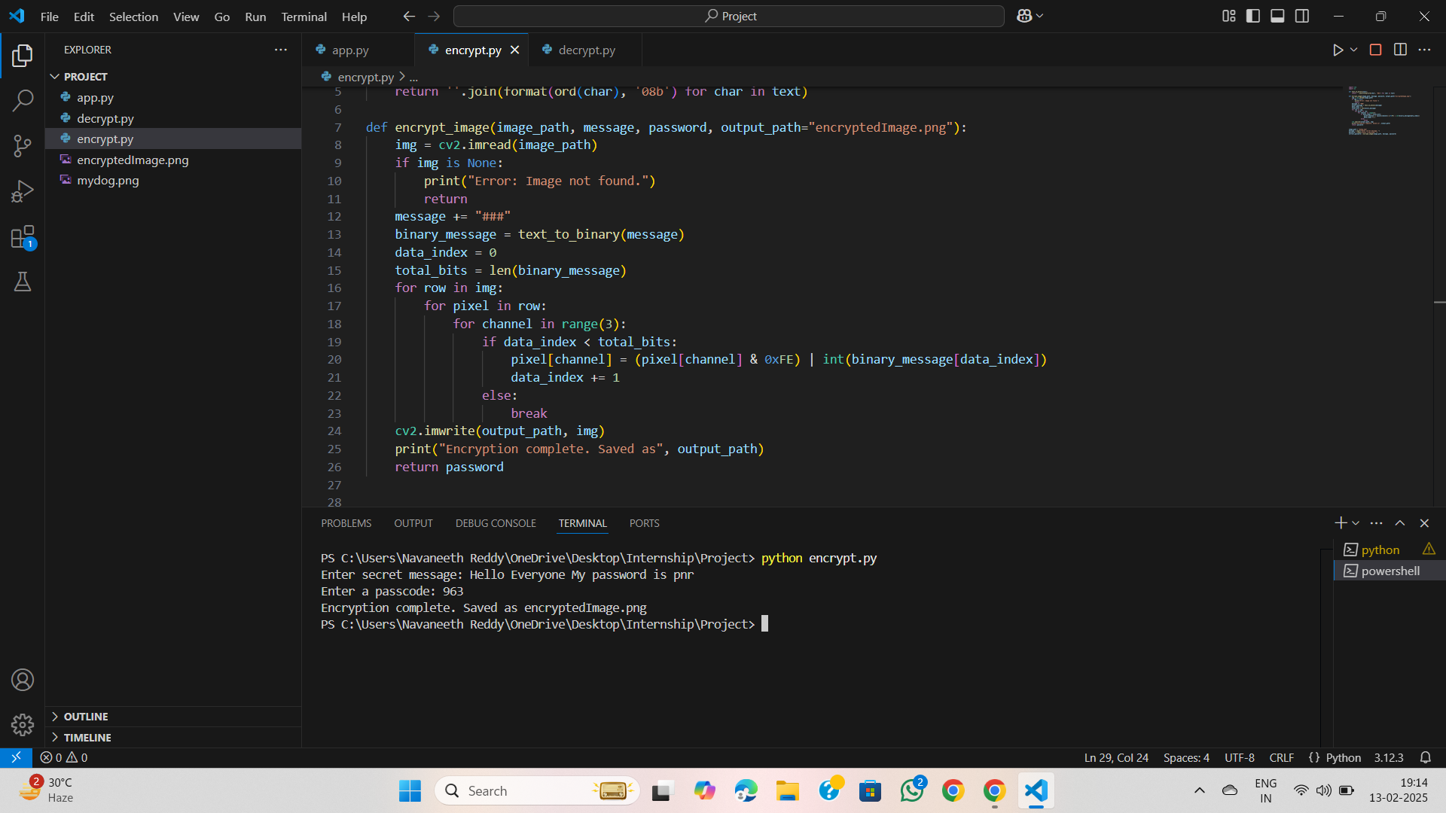
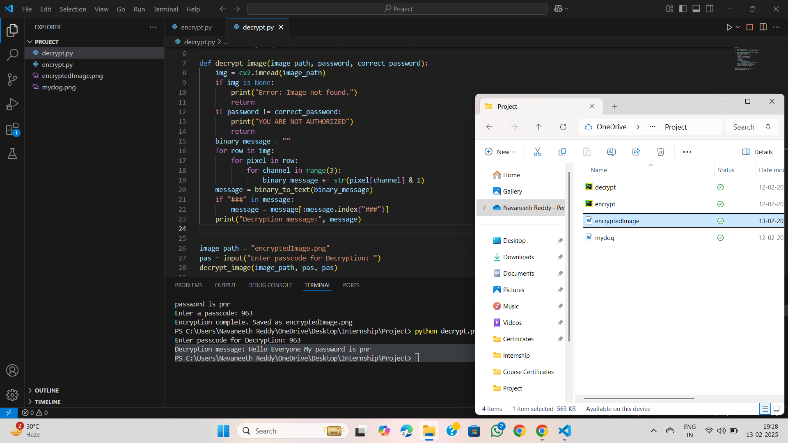
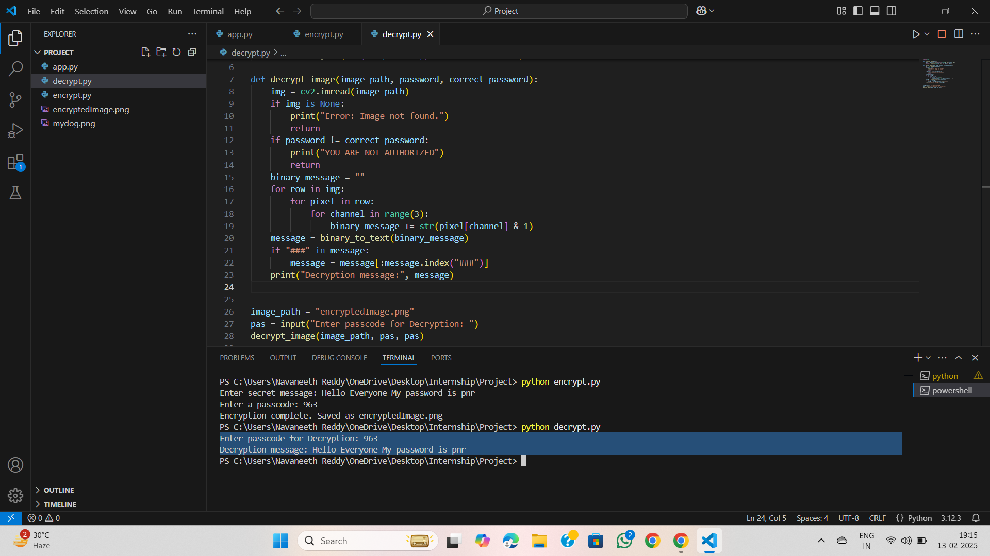
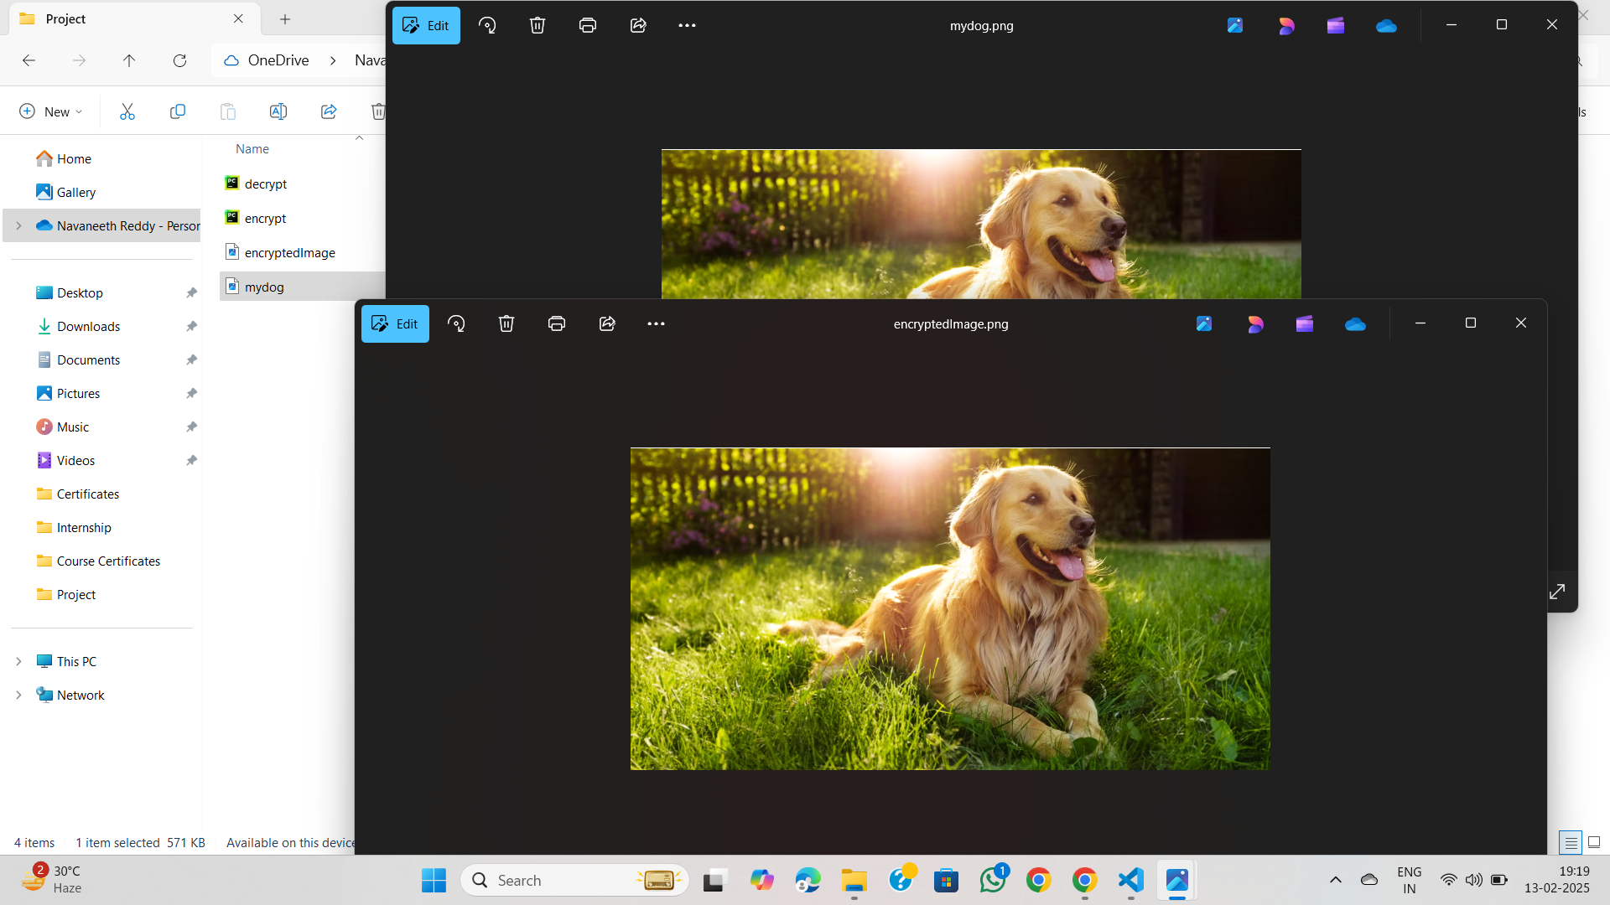
Results

Slide 8
Conclusion
This project successfully implements secure image steganography.
It enables confidential data transmission with minimal risk of detection.
Passcode protection enhances security for sensitive communications.
Applicable in cybersecurity, government, and personal privacy domains.

Slide 9
GitHub Link
https://github.com/pnavaneethreddy/Secure-Data-Hiding-in-Images-using-Steganography.git

Slide 10
Future scope
• AI-based steganalysis resistance
• Support for video and audio steganography
• Real-time encrypted messaging using steganography

Slide 11
THANK YOU

